Slide 1
ELITA
Enhanced Logging & Intelligent Telemetry Assistant

Slide 2
Overview
Our Team
Challenge
Solution Approach
Technology Stack
Architecture Diagram
Implementation Details
Demo

Slide 3
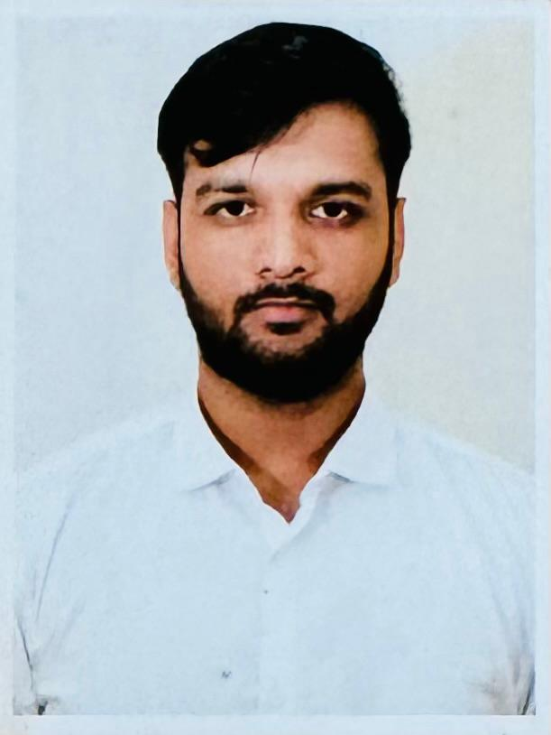
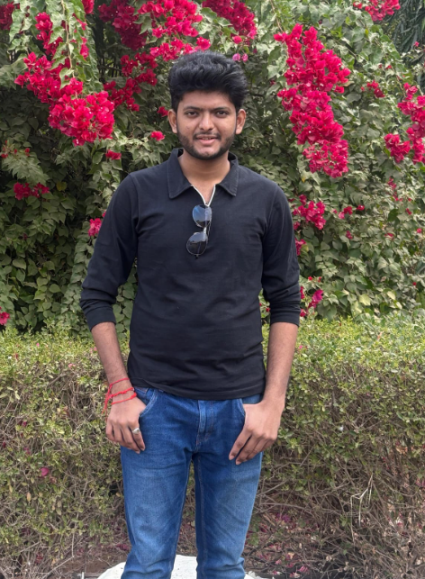
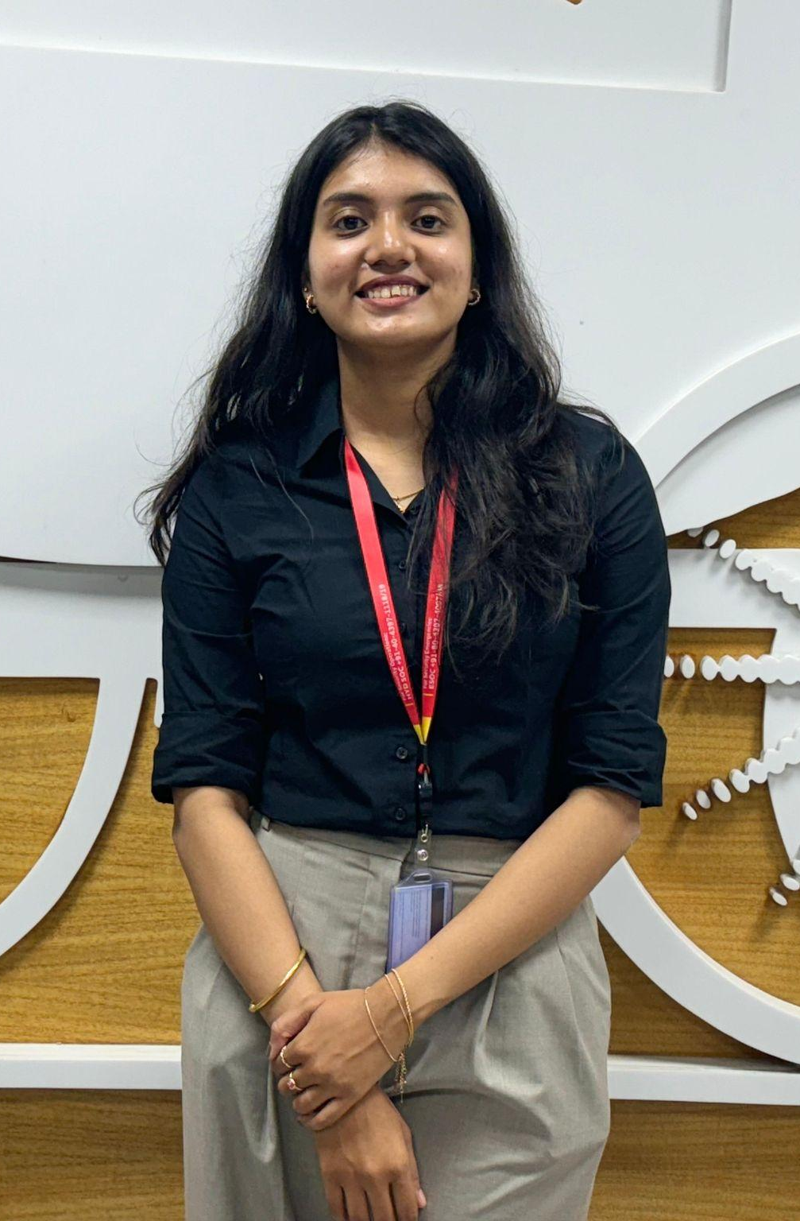
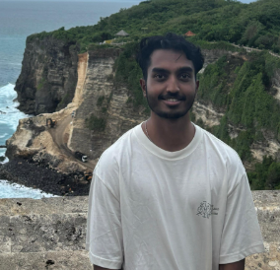
Introducing Team Members
Barath Srinivasan
OFA (CTO)
Nilay Shah
OFA (CTO)
Tanvi Kasande
OFA (CTO)
Subhash Raja
CMT(CCIBT)

Slide 4
Challenge
We have large number of support engineers across the organization who provide application and infrastructure support across L1/L2/L3 levels. This requires troubleshooting, accessing variety of knowledge base articles, running automations, reviewing telemetry data and metrics, health metrics, etc. This process requires lot of context switching leading to significant time and effort overhead for the support engineer.

Slide 5
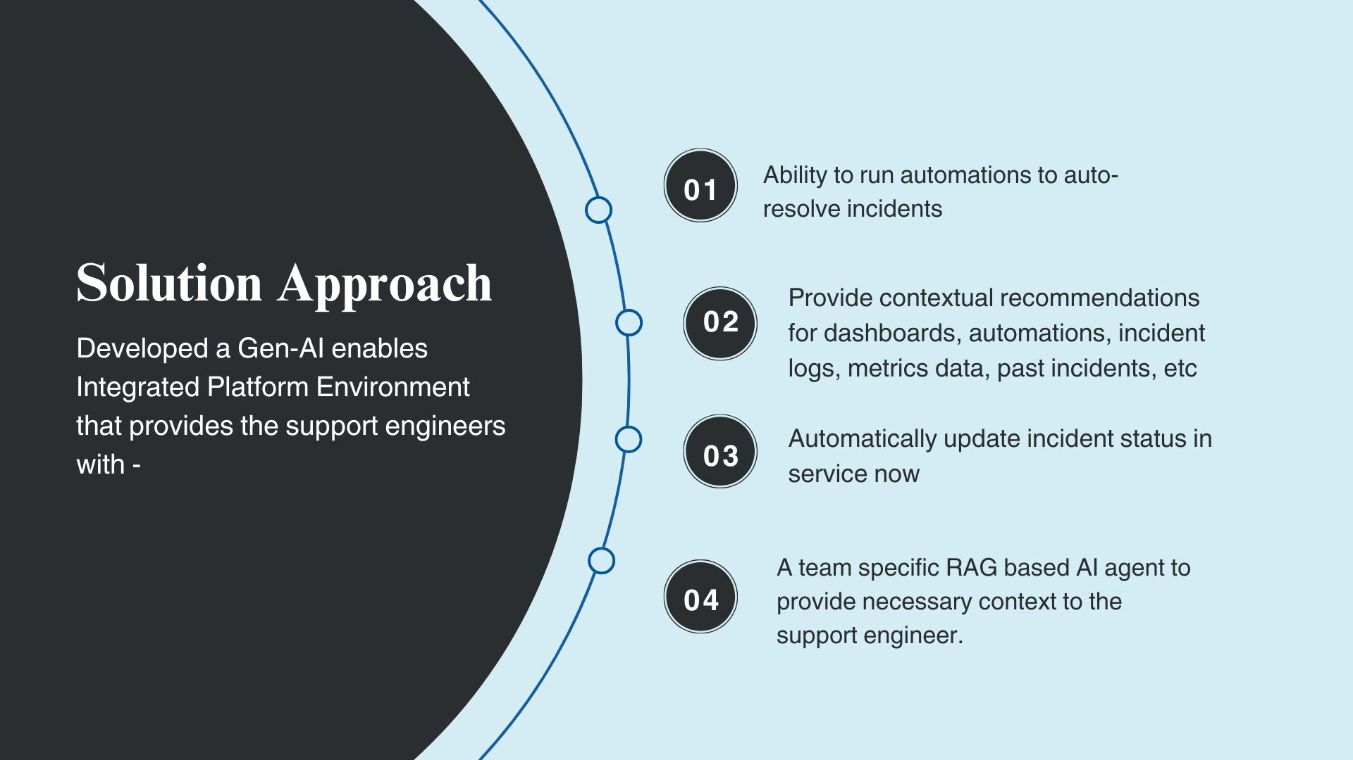
Solution Approach

Slide 6
Technology Stack
Backend: Python, Django
API Development & Testing: Postman
AI components: Vector databases, Retrieval Augmented Generation
Foundational model & NLP: OpenAI API (text-embedding-3-small), GPT-3o
Database: MongoDB
Containerization & Deployment: Docker, Azure
ITSM Integration: ServiceNow
Monitoring & Visualization: Grafana, System Logs

Slide 7
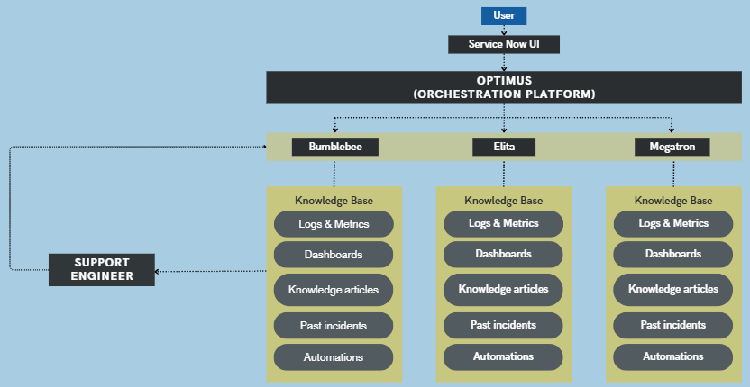
Architecture Diagram (Application Overview)

Slide 8
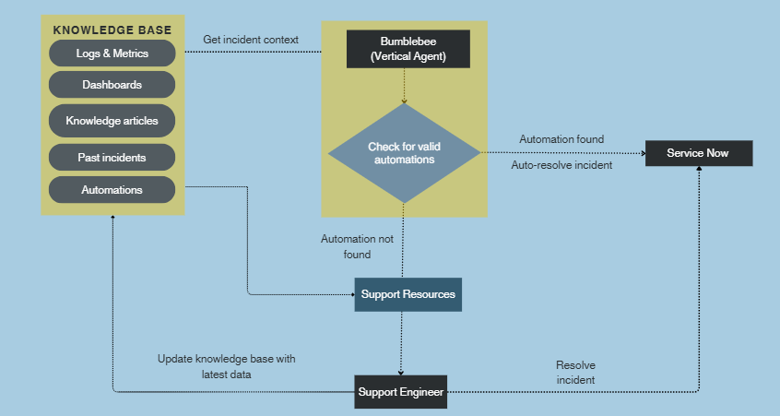
Architecture Diagram ( Vertical Agent)

Slide 9
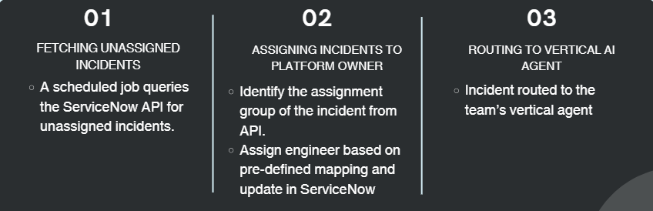
Implementation Details
Backend Service - Optimus Agent
Optimus is a micro-service based agent that fetches unassigned ServiceNow incidents and routes it to the correct vertical agent.

Slide 10
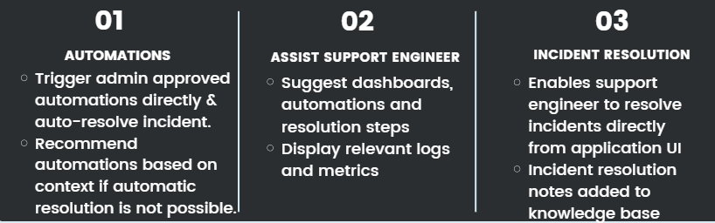
Implementation Details
2. AI Powered - Vertical Agent
Team specific agent which will helps the support engineer to resolve an incident

Slide 11
Deployment Strategy
Separate microservices for Optimus and other vertical agents for scalability.
All services run as docker containers in Azure VM

Slide 12
Demo

Slide 13
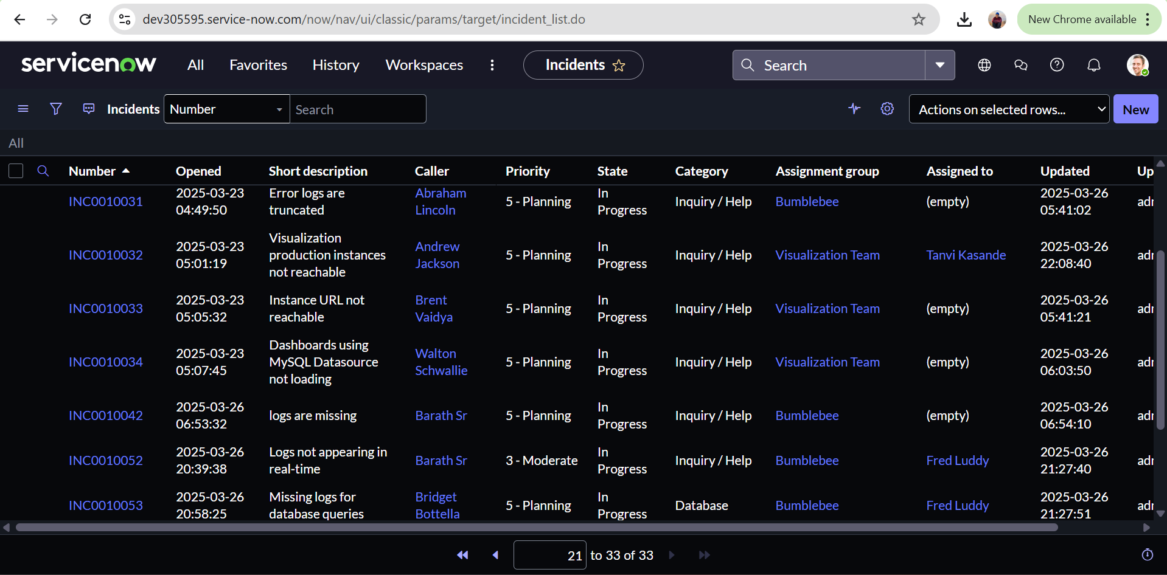
ServiceNow UI for raising incidents
All incidents
Create new incident

Slide 14
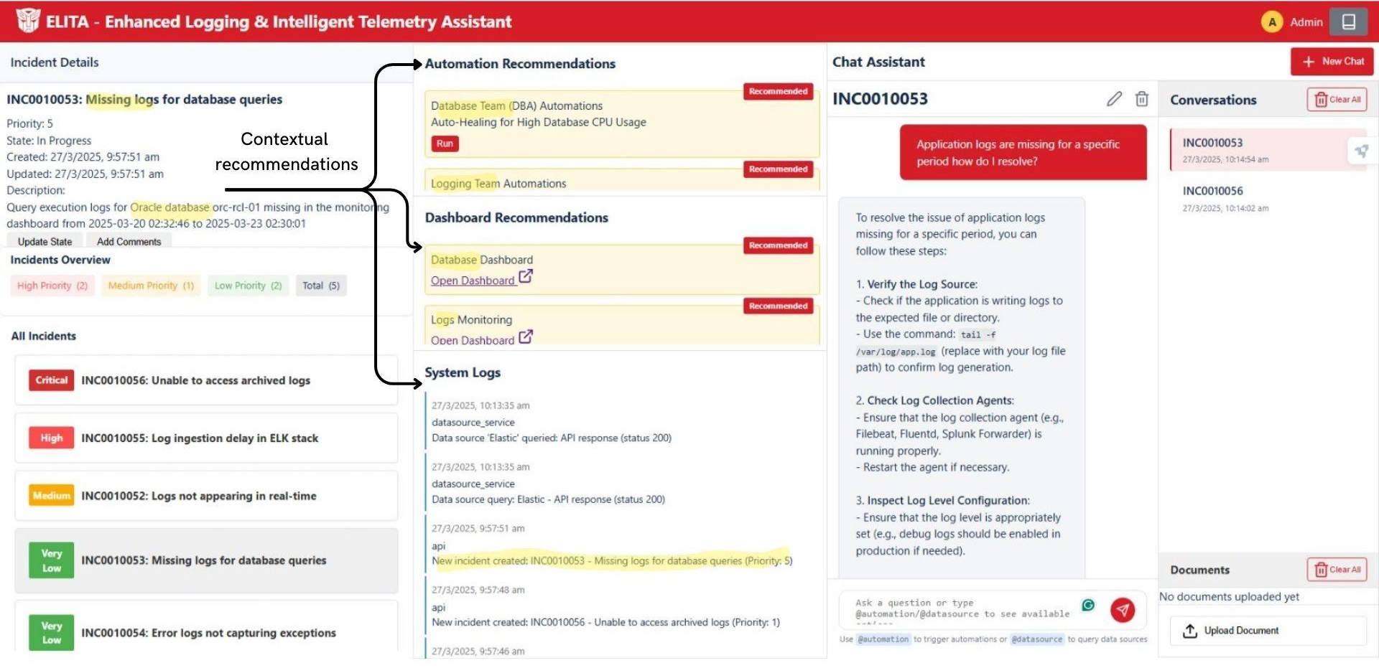
ELITA- AI based vertical agent

